Slide 1
PACER Peripheral Activity Completion Estimation and Recognition
Daniel R. Moore Ph.D., P.E.
drmoore@gmail.com
https://www.linkedin.com/in/drmoorepe
Alexander G. Dean Ph.D.
agdean@ncsu.edu
April 25th, 2018

Slide 2
Outline
Motivating Examples (2m)
Observations and Apparatus (5m)
PACER (5m)
Results (8m)
Questions are welcome throughout!

Slide 3
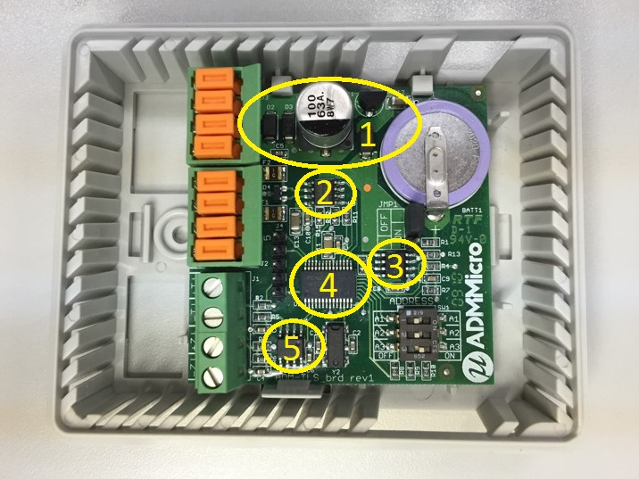
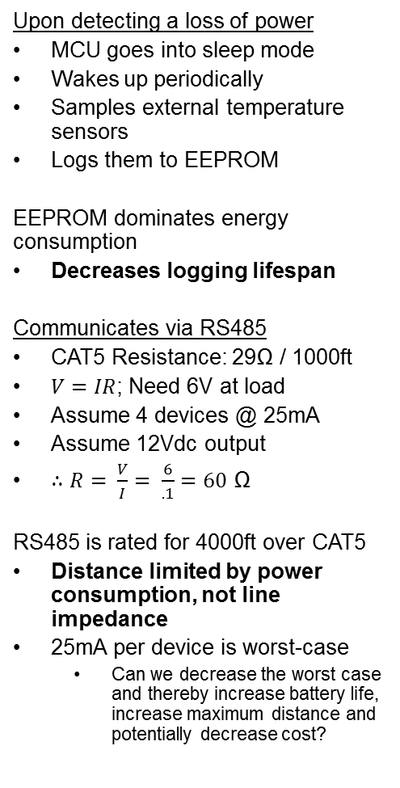
Motivating Example: Logging Sensor
Upon detecting a loss of power
MCU goes into sleep mode
Wakes up periodically
Samples external temperature sensors
Logs them to EEPROM
EEPROM dominates energy consumption
Decreases logging lifespan
Communicates via RS485
CAT5 Resistance: 29Ω / 1000ft
$V=IR$; Need 6V at load
Assume 4 devices @ 25mA
Assume 12Vdc output
$∴R= \frac{V}{I}= \frac{6}{.1}=60$ Ω
RS485 is rated for 4000ft over CAT5
Distance limited by power consumption, not line impedance
25mA per device is worst-case
Can we decrease the worst case and thereby increase battery life, increase maximum distance and potentially decrease cost?
Commercial / Industrial Temperature Logger
Power Supply
RS485 Communications
Non-Volatile Storage (EEPROM)
Micro-controller
Analog Input

Slide 4
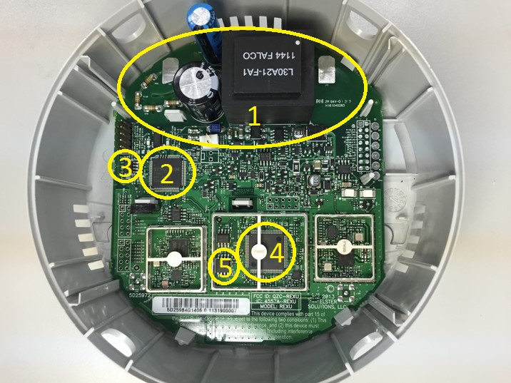
Motivating Example: Electricity Meter
Metrology + Comms Processors
Uses EEPROM
Energy Usage
Demand Intervals
Profile Information
NV-RAM
Communications MCU
Uses Serial flash
Network routing data
Firmware Updates
NV-RAM
Capacitor allows the system to run for a period of time after power fails
Some values need to be updated constantly and preserved across power failures
Typically indexes into logs
Energy accumulations
Status information
EEPROM has a limited write-cycle count (~1,000,000)
Serial flash is typically ~100,000
Solution: Use RAM, and interrupt to back it up as power fail occurs
Requires a capacitor capable of holding Vdd while backup is in progress
Storage capacity is best described as energy limited!
Actual communication is only 7.7% of the total write time. The other 92.3% is a mandatory wait period imposed by the chip ‘page-write time’
Residential / Commercial Electricity Meter
Power Supply / Metering
Metering MCU
Metering EEPROM
Communications MCU
Communications Serial Flash

Slide 5
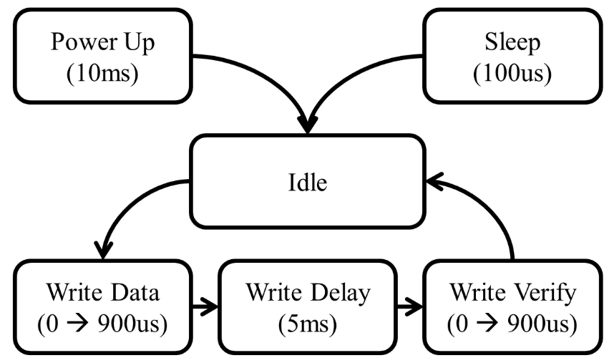
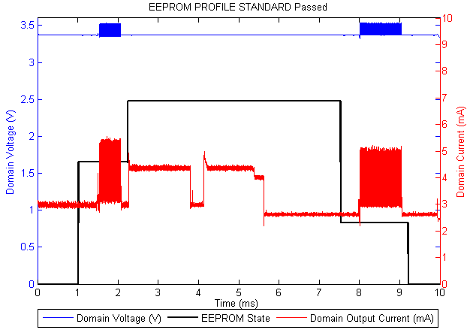
IODVS Observations
EEPROM Datasheet derived
timing diagram:
Device timing is specified for the worst case per the data sheet. Timing slack exists.
The current profile of most devices indicates early completion
Can we identify early completions to further reduce energy consumption (and reduce latency)?
Via: Time? – Energy? – Current?
Need real-time actionable intelligence!

Slide 6
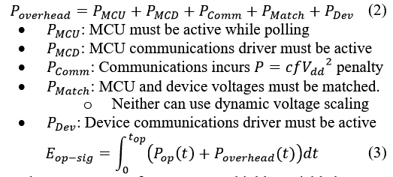
IODVS Observations
Why not just use interrupts?
Not universally supported
Extra conductor (cost, weight, power, performance)
Can’t perform IODVS (signaling voltage V_{dd-io} is terminated)
Why not poll?
If we succeed, then we have created a “virtual interrupt” line!

Slide 7
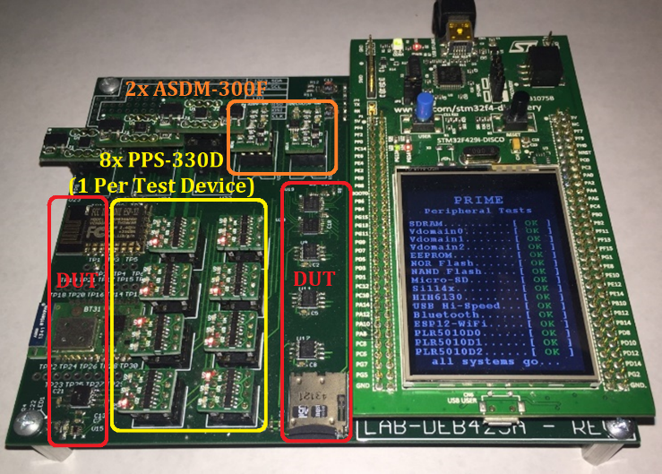
PRIME
Precise Real-time In-circuit
Micro Energy management system
Hosts the STM32 Discovery Board
STM32F429 MCU @ 180MHz
2MB FLASH, 512KB RAM
3x simult. sampling ADCs
2.2 MSPS @ 10-bit resolution
Multi-channel DMA + MEM2MEM DMA
On board 64MB SDRAM
3 Voltage Domains (ASDM-300F)
Peripheral Device Isolation (PPS-330D)
USB 2.0 Hi-Speed Communication
Peripheral Devices Under Test (DUT)
Honeywell HIH6130 Environmental Sensor
Numonyx M25PX16 NOR Serial Flash
Si114x Optical Proximity Sensor
Microchip SBPT2632 Bluetooth
ESP8266 Wi-Fi
Programmable load regulators (PLR5010D)
Microchip 25AA512 EEPROM
Microchip SST26VF NAND Serial Flash
SPI Mode SD Cards
Lexar SDSC: 1.0GB
Sandisk: SDSC 1.0GB
Swissbit: SDSC 512MB
Kingston: SDSC 2.0GB

Slide 8
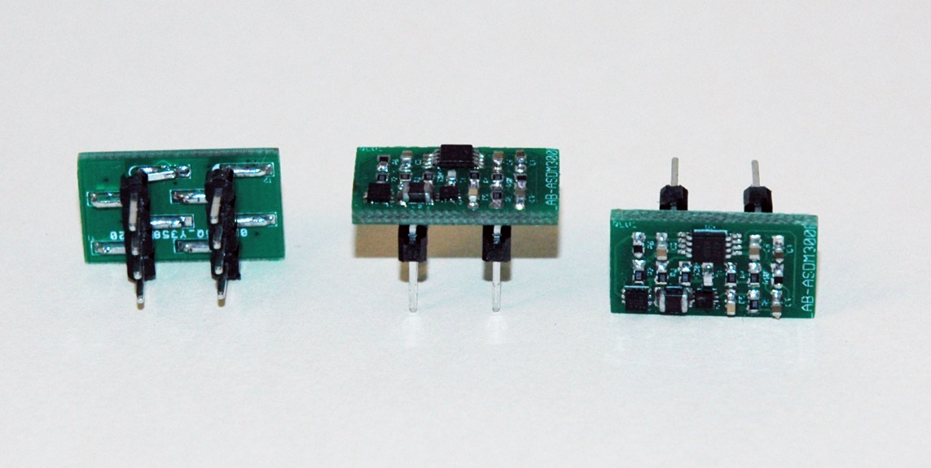
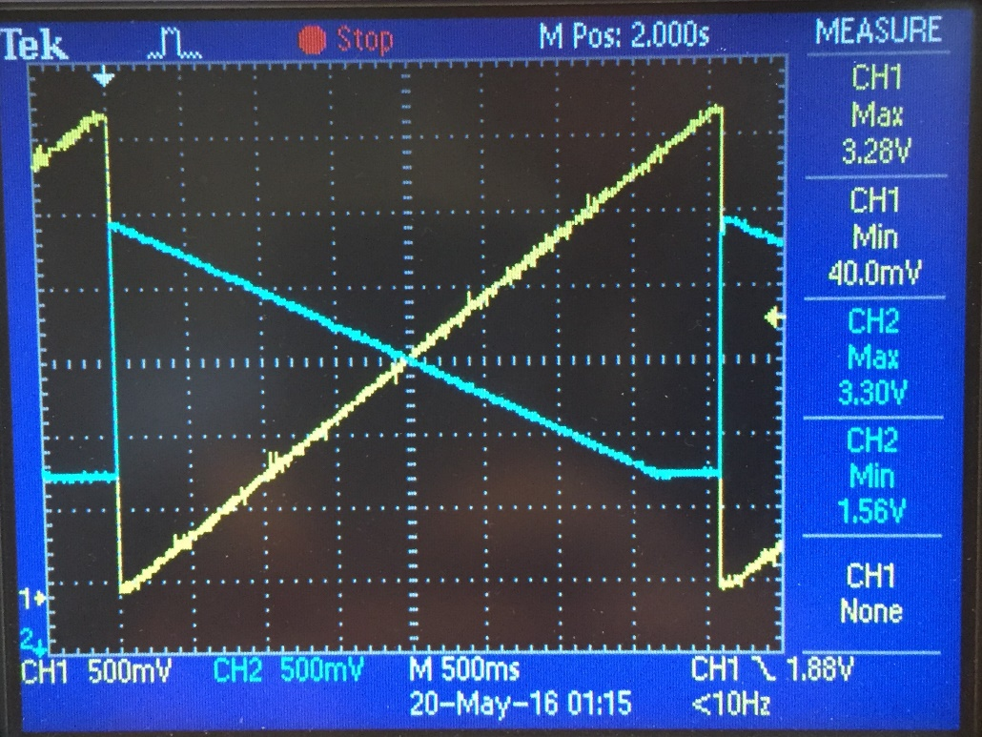
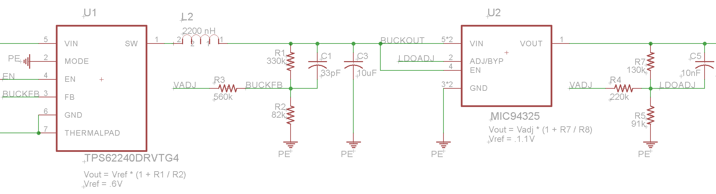
ASDM-300F
TPS62240 efficient at light loads: ~80% at 1mA
Additional Micrel LDO “Ripple-Blocker” regulator for lower switching noise
Lower than 20mvpp → Cannot measure via typical oscilloscope
Dual Channel Current Sense Amplifier MAX4377
For simultaneous measurement of input and output current
SMPS and LDO feedback adjust simultaneously
8-Pin DIP Pinout compatible
I/O current measured by MAX4376
“High Side” sense resistor is used, differential across is multiplied by the amplifier gain
2MHz GBP, G = 20

Slide 9
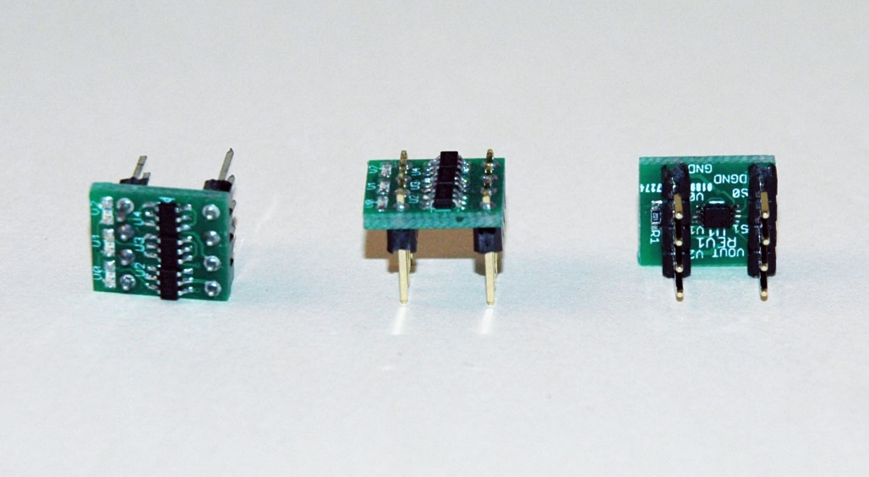
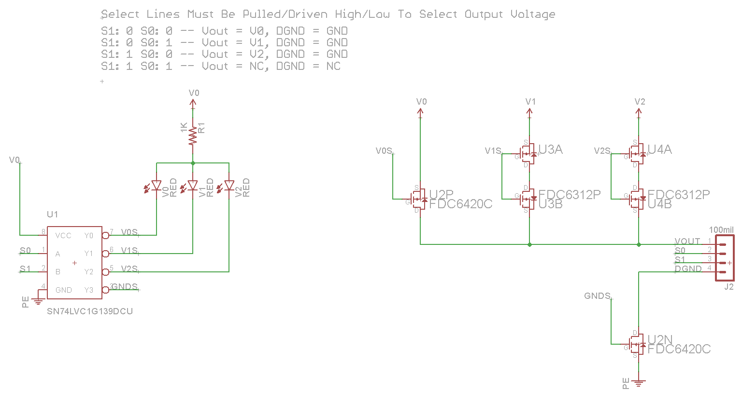
PPS-330D
Uses a 2→4 74HC139 decoder to switch the voltage domain supplied to an external peripheral
Ground can be disconnected entirely
8-Pin DIP pinout compatible

Slide 10
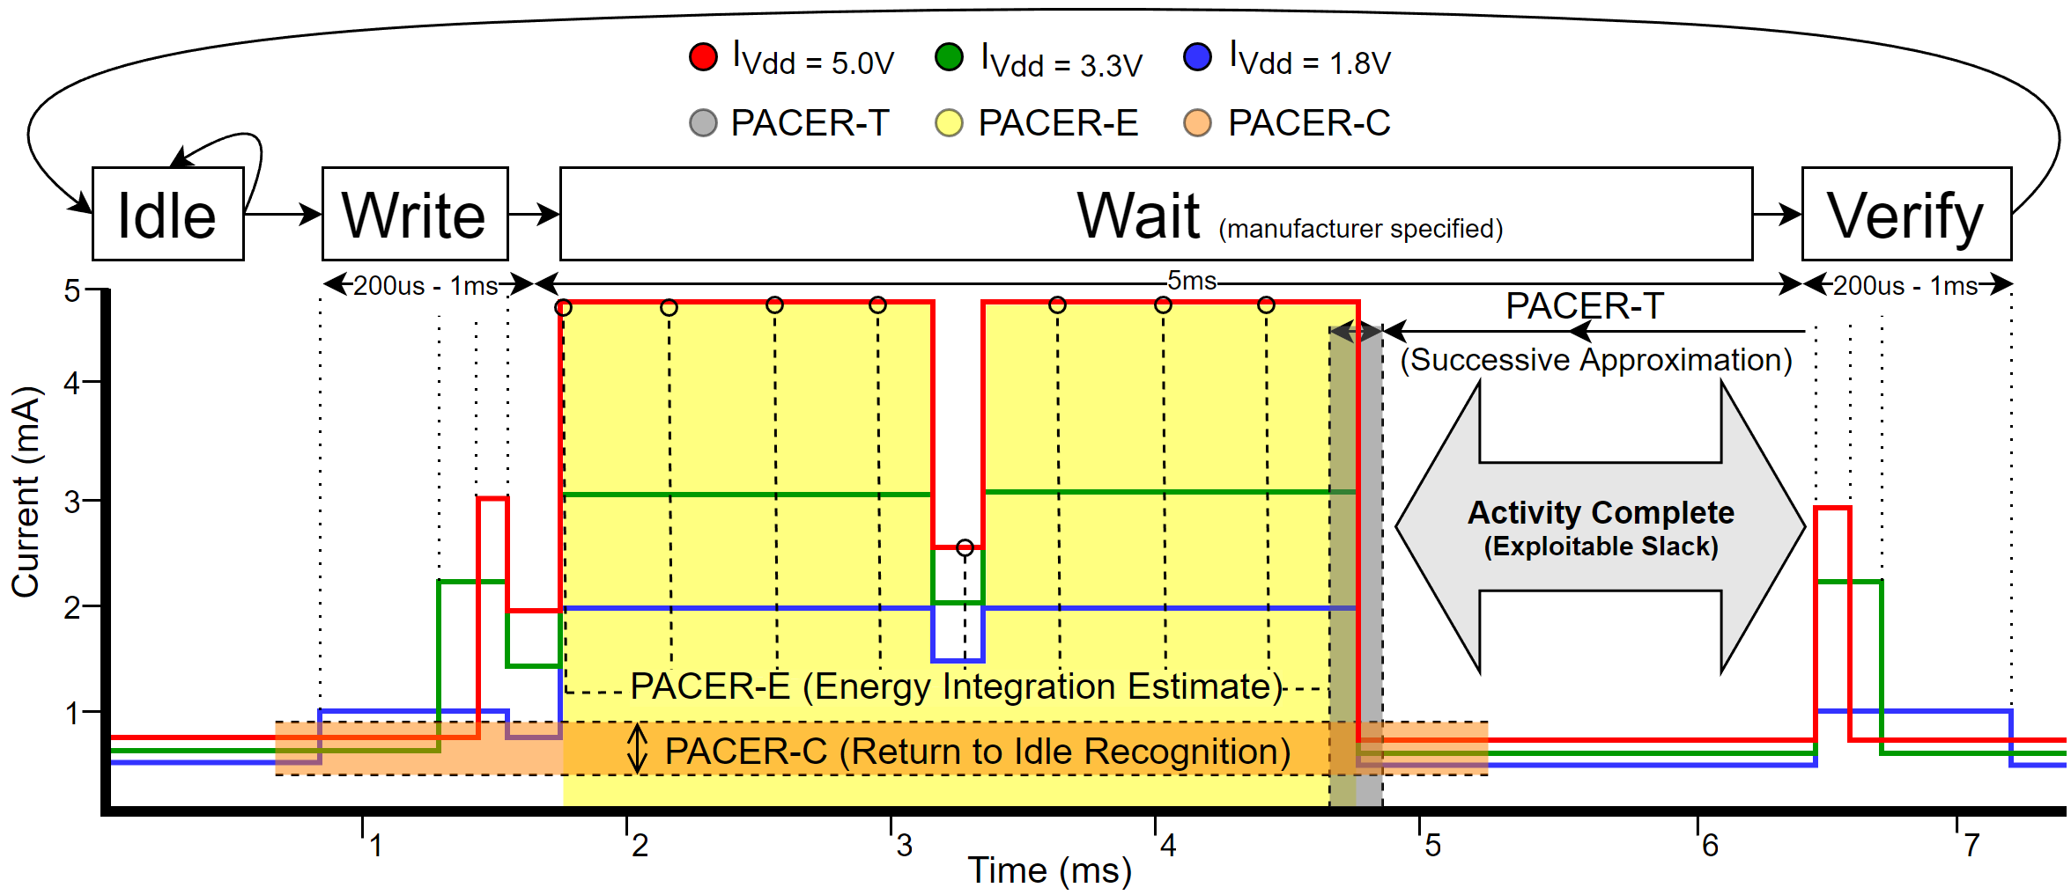
PACER Peripheral Activity Completion Estimation and Recognition
Use PRIME to detect early completion of peripheral operations
3 Algorithms available:
PACER-T: Time heuristic, PACER-E: Energy heuristic, PACER-C: Current heuristic
Sub-Operations specified as a triplet:
[T1, E1, C1]: Operation is considered complete when ANY of these conditions are satisfied
Operations specified as a set of up to 3 sub-operations:
[[T1, E1, C1], [T2, E2, C2], [T3, E3, C3]]: Suitable for devices like serial flash
Diversify your metrics among sub-operations: time for sub-op1, energy for sub-op2, etc.

Slide 11
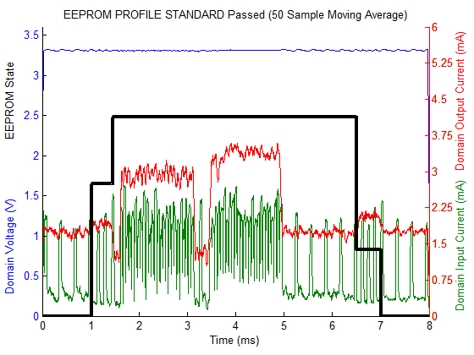
EEPROM: PACER-E

Slide 12
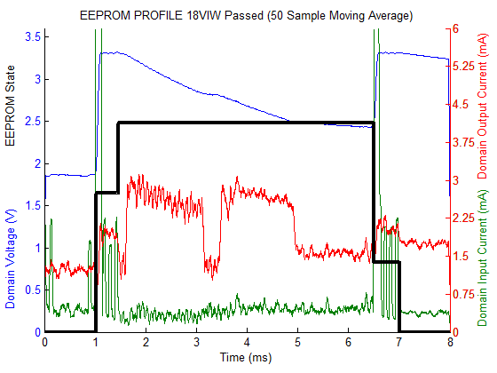
EEPROM: PACER-E + IODVS

Slide 13
EEPROM Results
Energy (uJ)
State | Control | IODVS | PACER-T | PACER-T + IODVS | PACER-E | PACER-E + IODVS | PACER-C | PACER-C + IODVS
Idle | 6.03 | 2.47 | 6.04 | 2.52 | 6.06 | 2.47 | 6.13 | 2.48
Writing | 2.71 | 2.55 | 2.73 | 2.51 | 2.69 | 2.50 | 2.80 | 2.58
Waiting | 46.84 | 33.85 | 37.89 | 27.85 | 33.59 | 25.06 | 35.47 | 26.24
Read | 3.50 | 3.48 | 3.29 | 2.04 | 3.51 | 3.49 | 3.55 | 3.21
Idle | 5.89 | 5.76 | 15.30 | 13.42 | 14.97 | 14.16 | 14.50 | 14.03
Test Total | 53.05 | 39.88 | 43.91 | 32.40 | 39.79 | 31.06 | 41.82 | 32.03
Delta | 0.00% | -24.83% | -17.24% | -38.93% | -25.00% | -41.46% | -21.17% | -39.62%
Latency (ms)
State | Control | IODVS | PACER-T | PACER-T + IODVS | PACER-E | PACER-E + IODVS | PACER-C | PACER-C + IODVS
Idle | 1.025 | 1.025 | 1.026 | 1.025 | 1.026 | 1.025 | 1.038 | 1.038
Writing | 0.429 | 0.43 | 0.429 | 0.429 | 0.429 | 0.43 | 0.429 | 0.429
Waiting | 5.045 | 5.044 | 3.508 | 3.507 | 3.54 | 3.508 | 3.603 | 3.653
Read | 0.506 | 0.508 | 0.506 | 0.507 | 0.506 | 0.506 | 0.507 | 0.508
Idle | 0.994 | 0.992 | 2.53 | 2.531 | 2.498 | 2.53 | 2.422 | 2.371
Op. Total | 5.98 | 5.982 | 4.443 | 4.443 | 4.475 | 4.444 | 4.539 | 4.59
Delta | 0.00% | 0.03% | -25.70% | -25.70% | -25.17% | -25.69% | -24.10% | -23.24%
PACER algorithms reduced energy consumption by ~25%
PACER-E appears to be the most effective on its own for this device
PACER + IODVS dramatically reduced energy consumption
PACER algos are within the margin of error to each other for this case

Slide 14
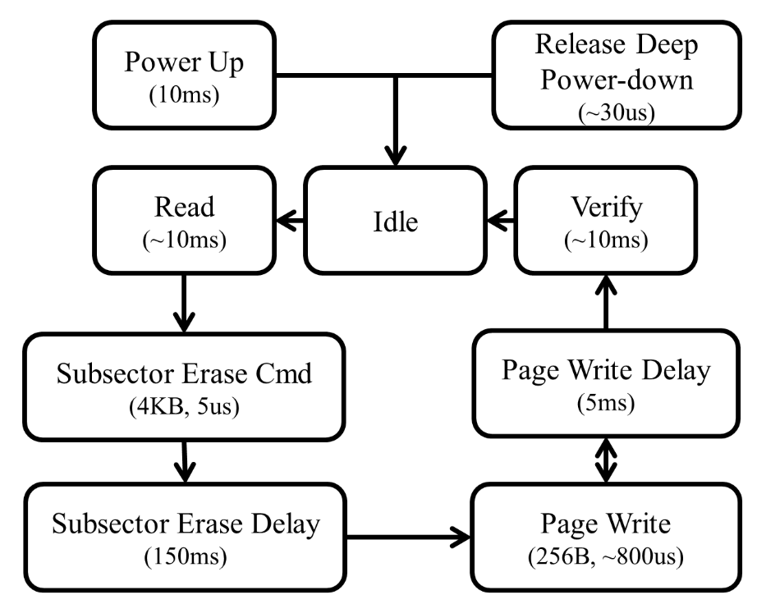
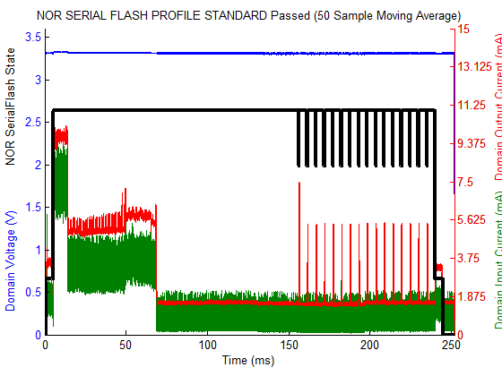
NOR Serial FLASH: PACER-T

Slide 15
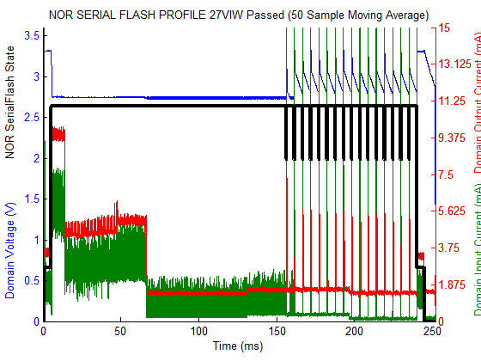
NOR Serial FLASH: PACER-T + IODVS

Slide 16
NOR Serial Flash Results
Energy (mJ)
State | Control | IODVS | PACER-T | PACER-T + IODVS | PACER-E | PACER-E + IODVS | PACER-C | PACER-C + IODVS
Idle | 6.04 | 4.66 | 6.05 | 4.61 | 6.07 | 4.65 | 6.15 | 4.63
Reading | 49.99 | 50.08 | 58.08 | 50.21 | 50.13 | 49.89 | 49.87 | 50.14
Erase | 0.95 | 0.96 | 0.91 | 0.94 | 0.96 | 0.97 | 0.99 | 0.95
Write Total | 39.17 | 36.31 | 63.05 | 41.26 | 37.68 | 20.40 | 37.36 | 17.81
Wait Total | 2138.32 | 1713.89 | 1211.99 | 1029.52 | 1501.73 | 1178.32 | 1319.34 | 1040.74
Reading | 48.60 | 48.78 | 51.91 | 31.72 | 48.59 | 33.76 | 48.47 | 42.02
Idle | 37.05 | 33.13 | 929.24 | 711.59 | 689.63 | 576.83 | 859.97 | 657.46
Total No Idle | 2277.02 | 1854.68 | 1391.98 | 1158.26 | 1645.17 | 1287.98 | 1462.18 | 1156.28
Delta | 0.00% | -18.55% | -38.87% | -49.13% | -27.75% | -43.44% | -35.79% | -49.22%
Latency (ms)
State | Control | IODVS | PACER-T | PACER-T + IODVS | PACER-E | PACER-E + IODVS | PACER-C | PACER-C + IODVS
Idle | 1.04 | 1.04 | 1.04 | 1.04 | 1.04 | 1.04 | 1.05 | 1.05
Reading | 4.27 | 4.27 | 4.27 | 4.27 | 4.27 | 4.27 | 4.27 | 4.27
Erase | 0.08 | 0.08 | 0.08 | 0.08 | 0.08 | 0.08 | 0.08 | 0.08
Write Total | 3.31 | 3.32 | 3.31 | 3.32 | 3.31 | 3.32 | 3.31 | 3.32
Wait Total | 231.57 | 231.57 | 69.47 | 66.92 | 104.81 | 120.17 | 80.15 | 79.06
Reading | 4.64 | 4.64 | 4.27 | 4.63 | 4.64 | 4.73 | 4.64 | 4.64
Idle | 7.09 | 7.08 | 169.55 | 171.74 | 133.86 | 118.38 | 158.50 | 159.57
Total No Idle | 243.87 | 244.92 | 82.45 | 80.26 | 118.14 | 133.62 | 93.50 | 92.43
Delta | 0.00% | 0.43% | -66.19% | -67.09% | -51.55% | -45.21% | -61.66% | -62.10%
PACER-T algorithm reduced energy consumption by ~39%
PACER + IODVS dramatically reduced energy consumption + latency
PACER-T + IODVS Reduced latency by 67%, and energy by 49%

Slide 17
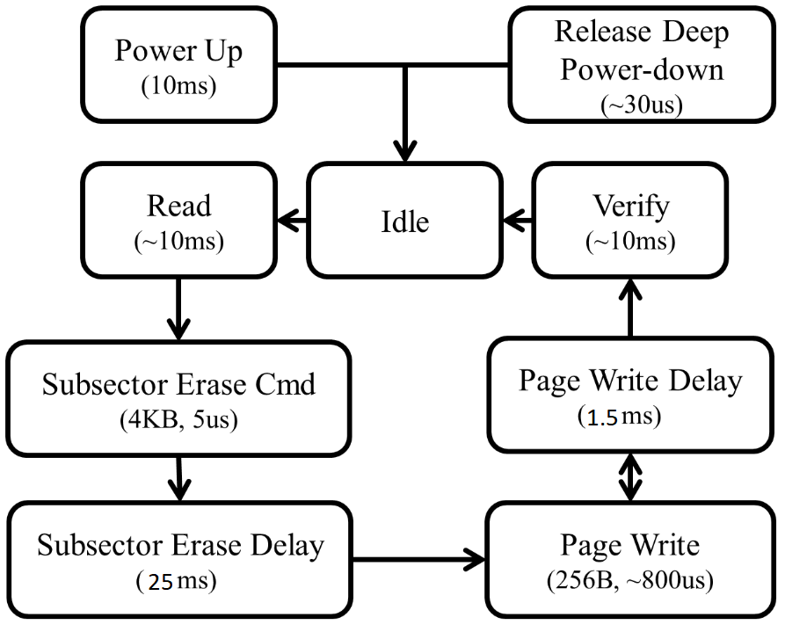
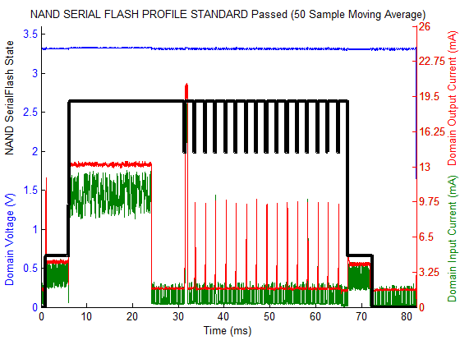
NAND Serial FLASH: PACER-T + IODVS

Slide 18
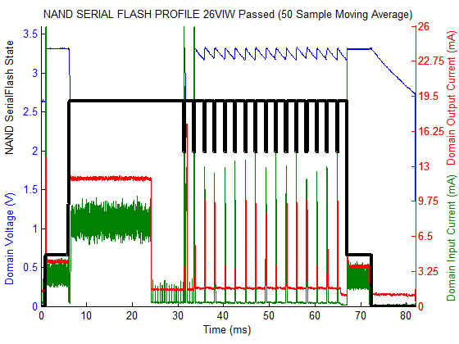
NAND Serial FLASH: PACER-T + IODVS

Slide 19
NAND Serial Flash Results
Energy (mJ)
State | Control | IODVS | PACER-T | PACER-T + IODVS | PACER-E | PACER-E + IODVS | PACER-C | PACER-C + IODVS
Idle | 5.62 | 4.12 | 5.54 | 4.07 | 5.58 | 4.08 | 5.64 | 4.14
Reading | 71.49 | 71.57 | 72.58 | 71.52 | 71.45 | 72.10 | 71.54 | 71.39
Erase | 1.58 | 1.59 | 1.53 | 1.58 | 1.55 | 1.49 | 1.55 | 1.52
Total Write | 51.88 | 48.14 | 75.40 | 70.70 | 73.01 | 70.19 | 51.63 | 44.66
Total Wait | 1052.98 | 806.15 | 802.63 | 584.87 | 817.59 | 596.84 | 887.28 | 670.32
Reading | 69.97 | 69.81 | 73.11 | 73.27 | 72.90 | 73.11 | 72.75 | 72.85
Idle | 52.31 | 44.66 | 249.37 | 187.25 | 234.28 | 158.54 | 149.37 | 133.95
Total No Idle | 1247.90 | 997.26 | 1025.25 | 801.95 | 1036.50 | 813.72 | 1084.76 | 860.73
Delta | 0.00% | -20.08% | -17.84% | -35.74% | -16.94% | -34.79% | -13.07% | -31.03%
Latency (ms)
State | Control | IODVS | PACER-T | PACER-T + IODVS | PACER-E | PACER-E + IODVS | PACER-C | PACER-C + IODVS
Idle | 1.04 | 1.04 | 1.04 | 1.04 | 1.04 | 1.04 | 1.05 | 1.05
Reading | 5.00 | 5.00 | 5.00 | 5.00 | 5.00 | 5.00 | 5.00 | 5.00
Erase | 0.08 | 0.08 | 0.08 | 0.08 | 0.08 | 0.08 | 0.08 | 0.08
Total Write | 3.31 | 3.32 | 3.31 | 3.31 | 3.31 | 3.32 | 3.31 | 3.31
Total Wait | 57.61 | 57.62 | 19.26 | 19.27 | 25.92 | 25.92 | 36.19 | 36.20
Reading | 5.28 | 5.28 | 5.29 | 5.29 | 5.28 | 5.28 | 5.28 | 5.29
Idle | 9.68 | 9.67 | 48.02 | 48.01 | 41.37 | 41.36 | 31.09 | 31.07
Total No Idle | 71.28 | 71.29 | 32.94 | 32.95 | 39.59 | 39.60 | 49.86 | 49.87
Delta | 0.00% | 0.01% | -53.79% | -53.78% | -44.46% | -44.45% | -30.05% | -30.03%
PACER-T algorithm reduced energy consumption by ~18%
PACER + IODVS dramatically reduced energy consumption + latency
PACER-T + IODVS Reduced latency by 54%, and energy by 36%

Slide 20
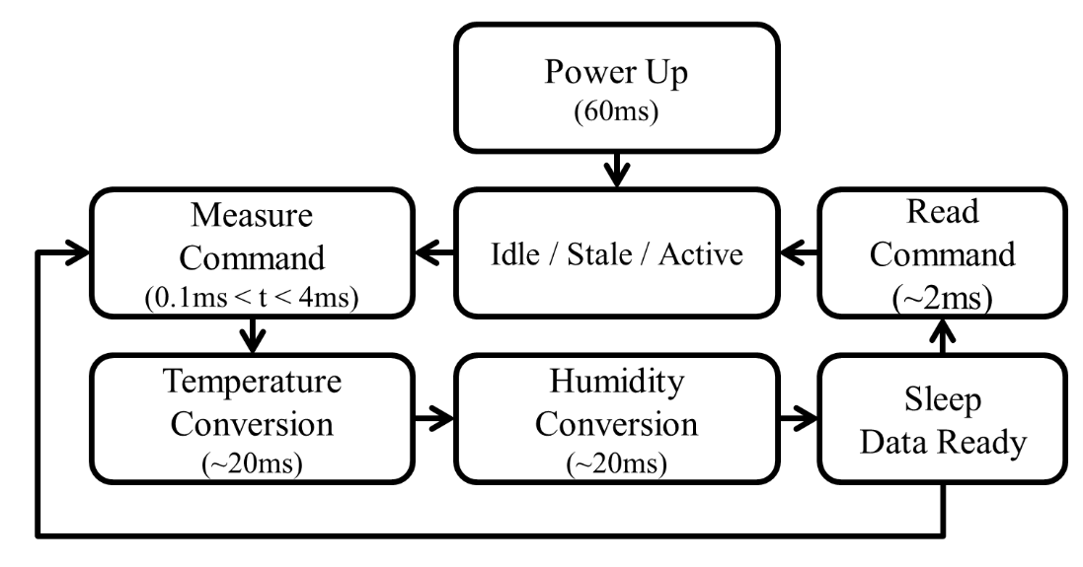
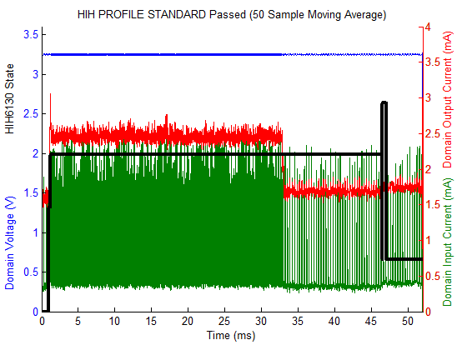
HIH-6130 Environment Sensor: PACER-T + IODVS

Slide 21
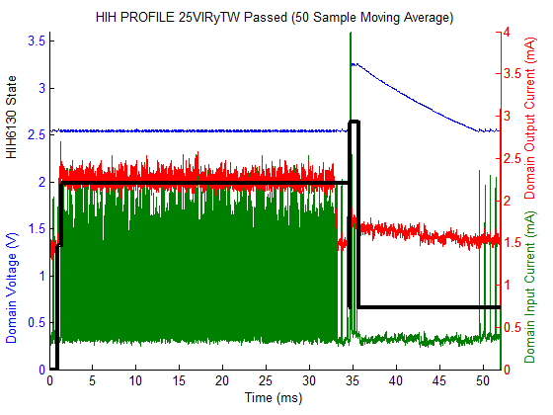
HIH-6130 Environment Sensor: PACER-T + IODVS

Slide 22
HIH6130 Environmental Sensor Results
Energy (mJ)
State | Control | IODVS | PACER-T | PACER-T + IODVS | PACER-E | PACER-E + IODVS | PACER-C | PACER-C + IODVS
Idle | 5.19 | 3.60 | 5.28 | 3.64 | 5.24 | 3.62 | 5.33 | 3.67
Writing | 1.75 | 0.98 | 1.76 | 0.93 | 1.73 | 0.98 | 1.76 | 1.00
Waiting | 325.95 | 231.17 | 254.14 | 120.39 | 240.29 | 169.62 | 223.65 | 159.00
Idle | 0.08 | 0.05 | 0.09 | 0.05 | 0.12 | 0.10 | 0.09 | 0.05
Reading | 2.80 | 2.64 | 2.98 | 3.10 | 3.37 | 3.30 | 2.95 | 2.92
Idle | 28.04 | 26.18 | 105.49 | 83.50 | 106.34 | 84.62 | 105.31 | 83.60
Active Total | 330.50 | 234.79 | 258.88 | 124.41 | 245.39 | 173.89 | 228.36 | 162.91
% Decrease | 0.00% | 28.96% | 21.67% | 62.36% | 25.75% | 47.39% | 30.91% | 50.71%
Latency (ms)
State | Control | IODVS | PACER-T | PACER-T + IODVS | PACER-E | PACER-E + IODVS | PACER-C | PACER-C + IODVS
Idle | 1.01 | 1.01 | 1.01 | 1.01 | 1.01 | 1.01 | 1.03 | 1.03
Writing | 0.23 | 0.44 | 0.23 | 0.44 | 0.23 | 0.44 | 0.23 | 0.44
Waiting | 45.27 | 45.27 | 31.66 | 31.44 | 31.45 | 31.41 | 31.70 | 31.60
Idle | 0.01 | 0.01 | 0.01 | 0.01 | 0.01 | 0.01 | 0.01 | 0.01
Reading | 0.49 | 0.95 | 0.49 | 0.95 | 0.49 | 0.95 | 0.49 | 0.95
Idle | 4.98 | 4.32 | 18.59 | 18.15 | 18.80 | 18.18 | 18.54 | 17.98
Active Total | 45.99 | 46.65 | 32.38 | 32.82 | 32.17 | 32.80 | 32.42 | 32.98
% Decrease | 0.00% | -1.44% | 29.59% | 28.63% | 30.05% | 28.69% | 29.50% | 28.28%
PACER algorithms reduced energy consumption by ~25%
PACER + IODVS dramatically reduced energy consumption + latency
PACER-T + IODVS Reduced latency by 54%, and energy by 36%

Slide 23
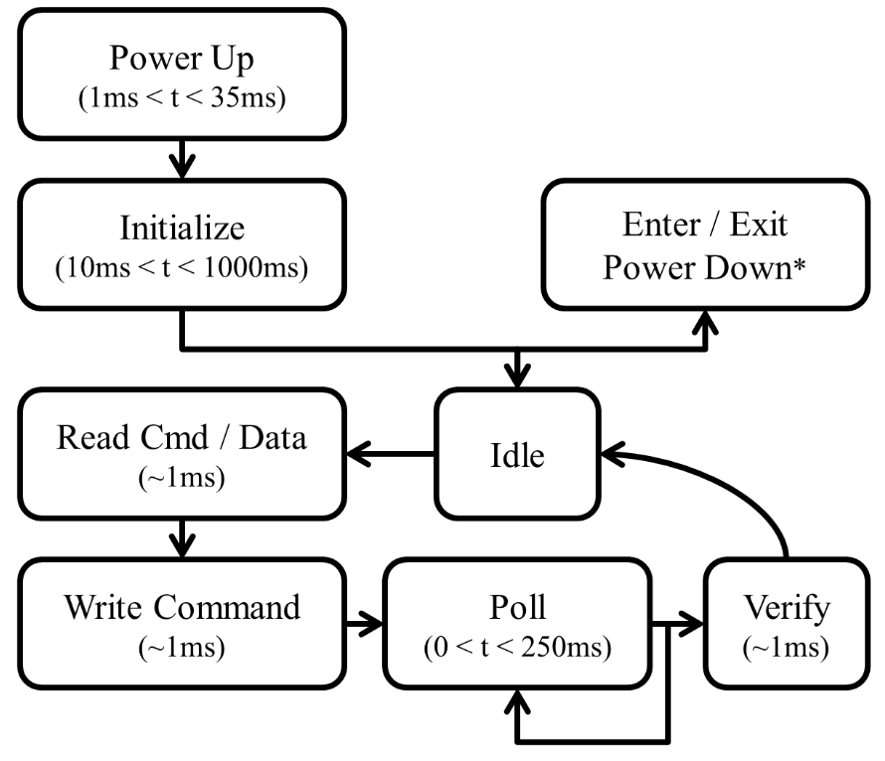
microSD Cards…
The protocol is polling based!
The current profile of the Swissbit microSD Card:
2048 averaged samples indicate completions at a wide variety of times!
Indicates onboard caching. We’ll prove it on each device.
Only PACER-C logically makes sense to detect these completions

Slide 24
Sandisk Caching Example
Typical IODVS write (cache miss)
PACER-C write
cache hit detected
Note the current multiple

Slide 25
Sandisk microSD Results
PACER-C improvement realizes the energy benefit of cache-hits

Slide 26
Lexar microSD Results

Slide 27
Swissbit microSD Results
PACER-C improvement realizes the energy benefit of HIGHLY variable response times

Slide 28
Kingston microSD Results
PACER-C improvement limited by highly clustered response times, extremely fast operation times, low wait-energy penalty. Still, slightly faster response time

Slide 29
PACER Results / Analysis
Significant energy / latency savings on its own merit
Enhanced further by IODVS and provides completion detection
PACER-T and PACER-C are most effective for the devices tested
PACER-T requires no extra circuitry whatsoever
PACER-E requires analog feedback but is computationally friendly
DMA + MAC units are currently very common on MCU
PACER-C can provide the best performance for highly non-deterministic response times.
May be MCU friendly if specialized ADC HW is available – there currently exists interrupt-on-threshold MCU hardware

